Slide 1
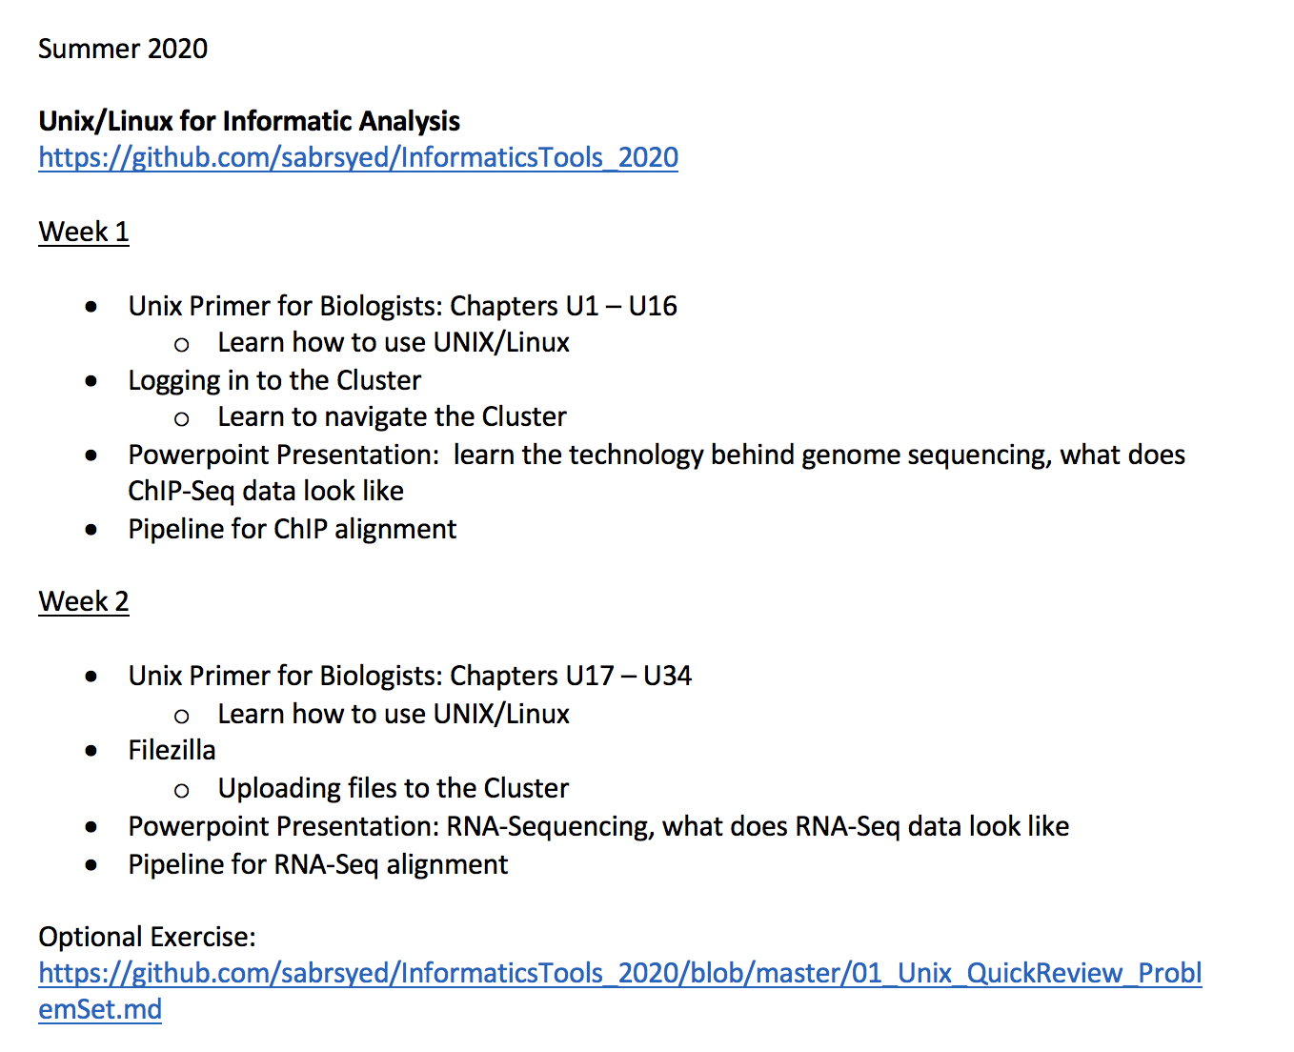

Slide 2


Slide 4
Unix Primer for Biologists, Chapters U1-U16

Slide 6
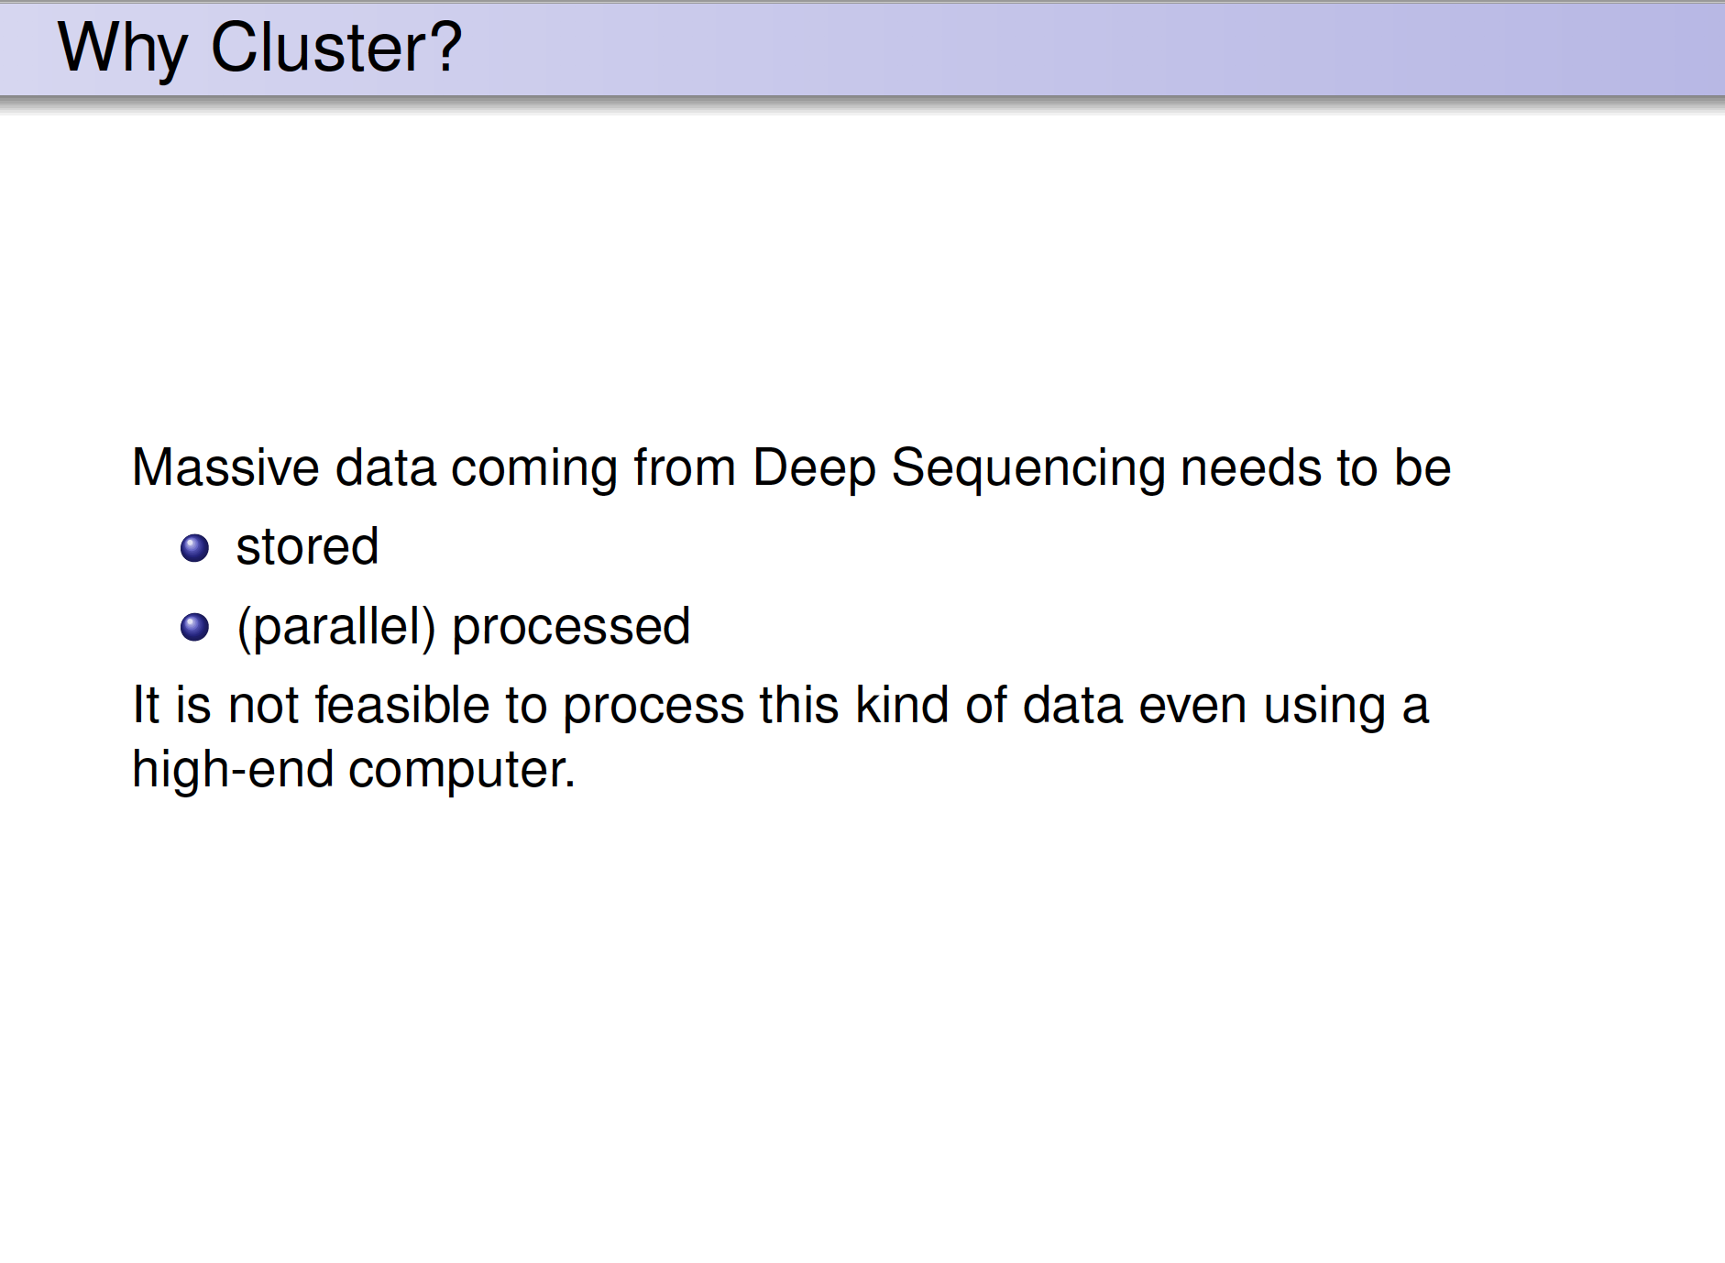

Slide 7
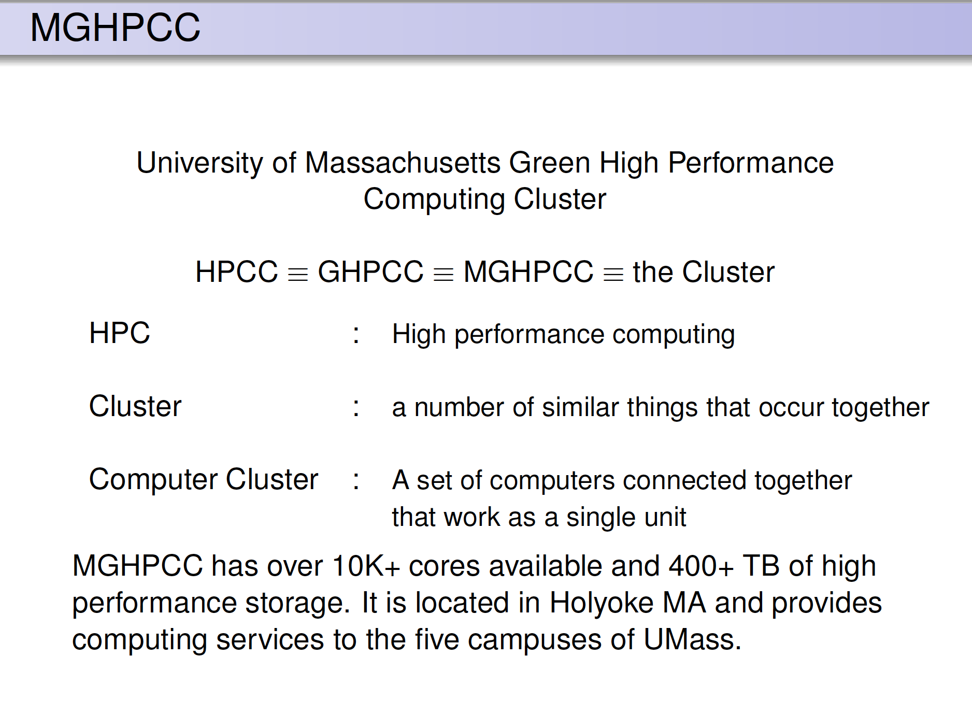

Slide 8
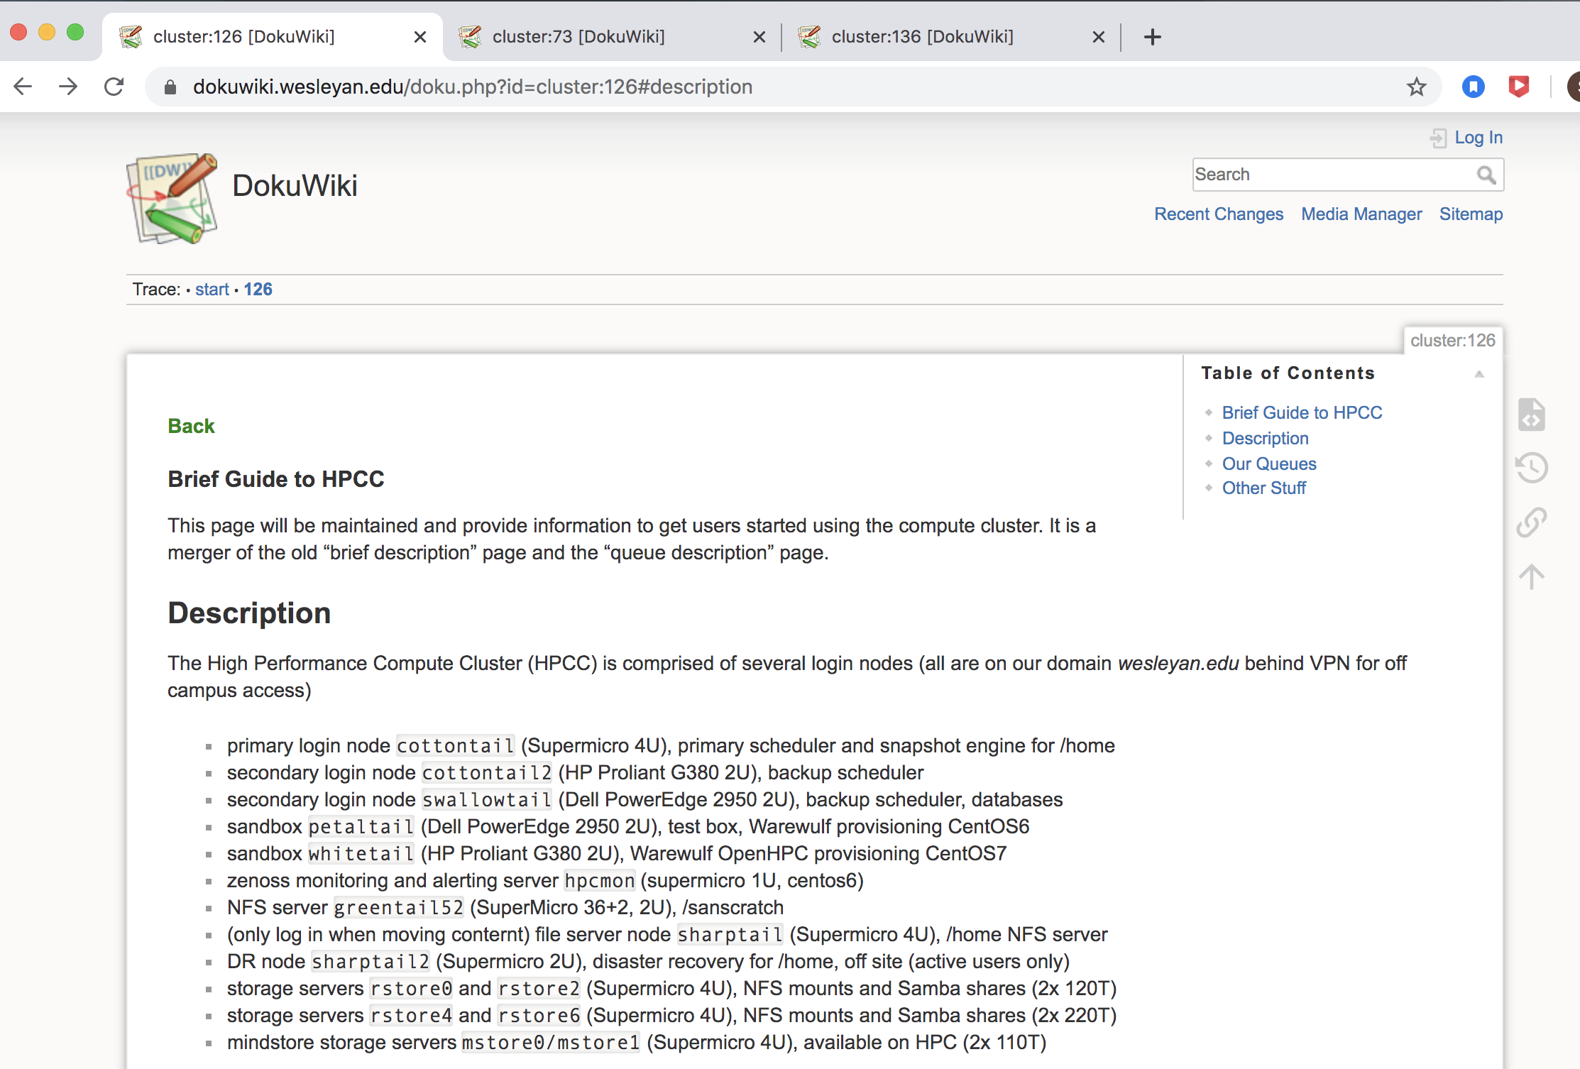

Slide 9
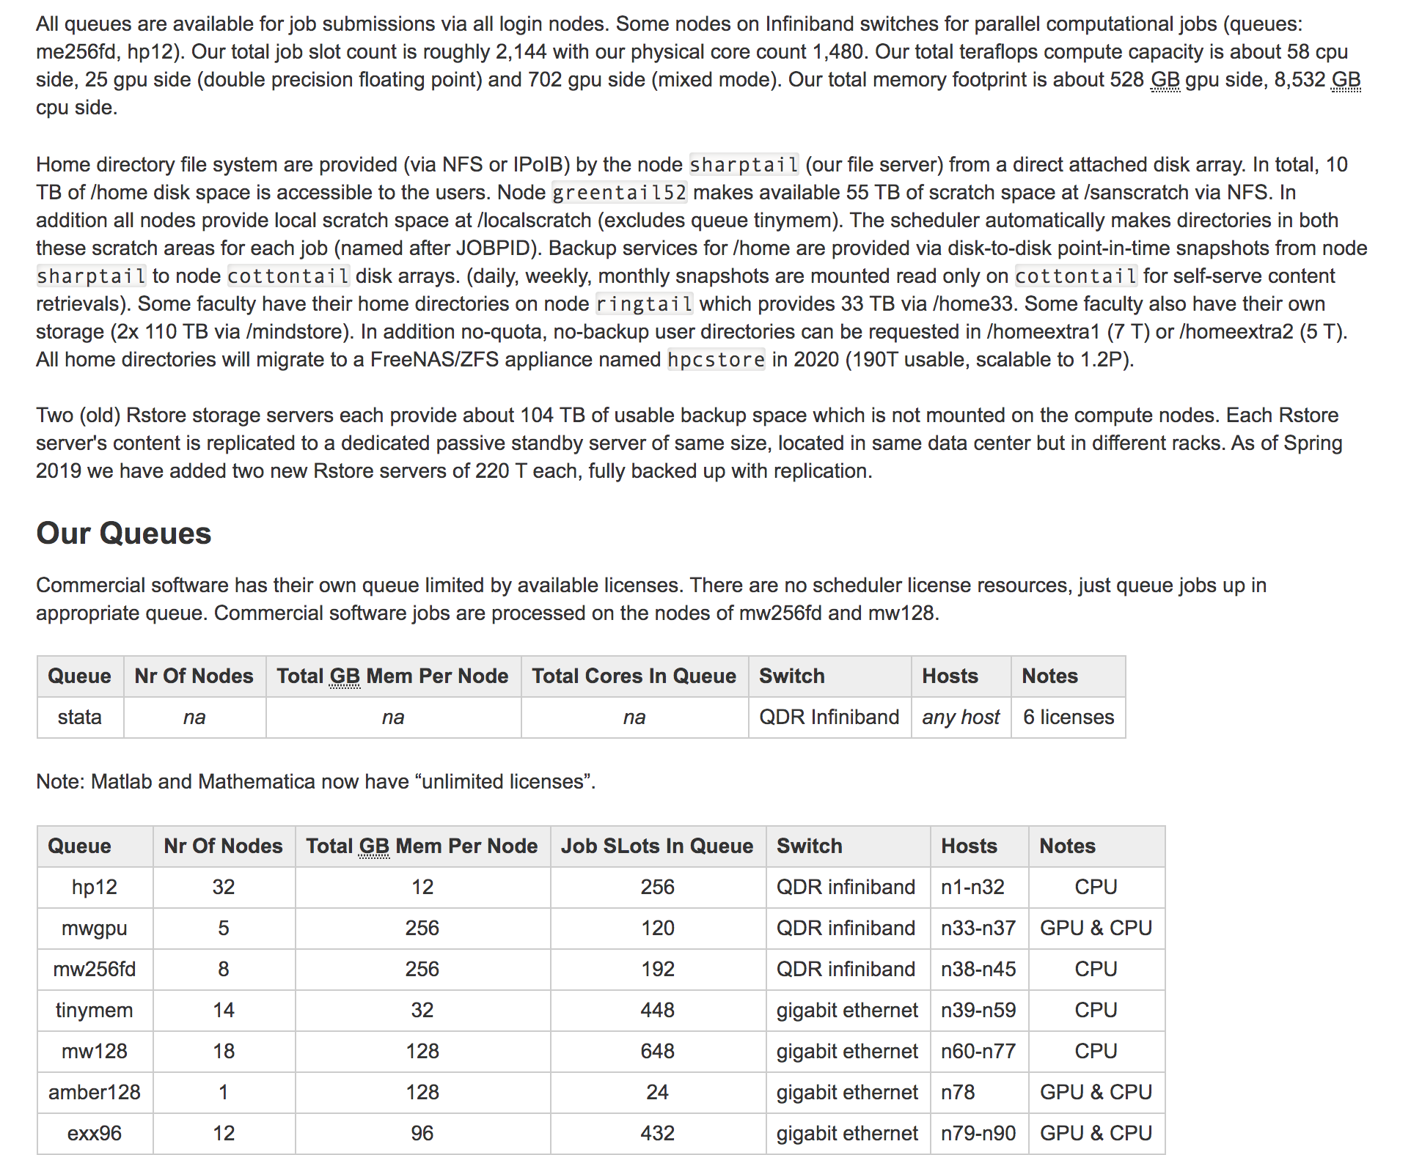

Slide 10
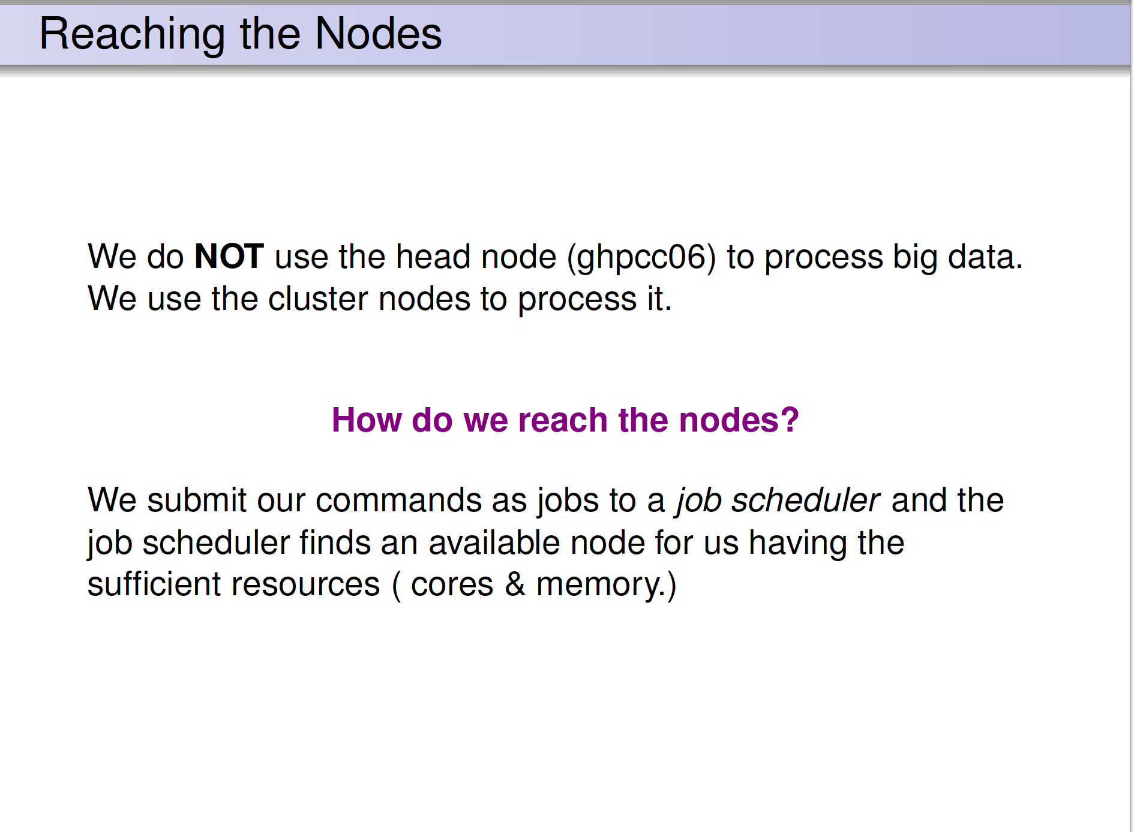

Slide 11
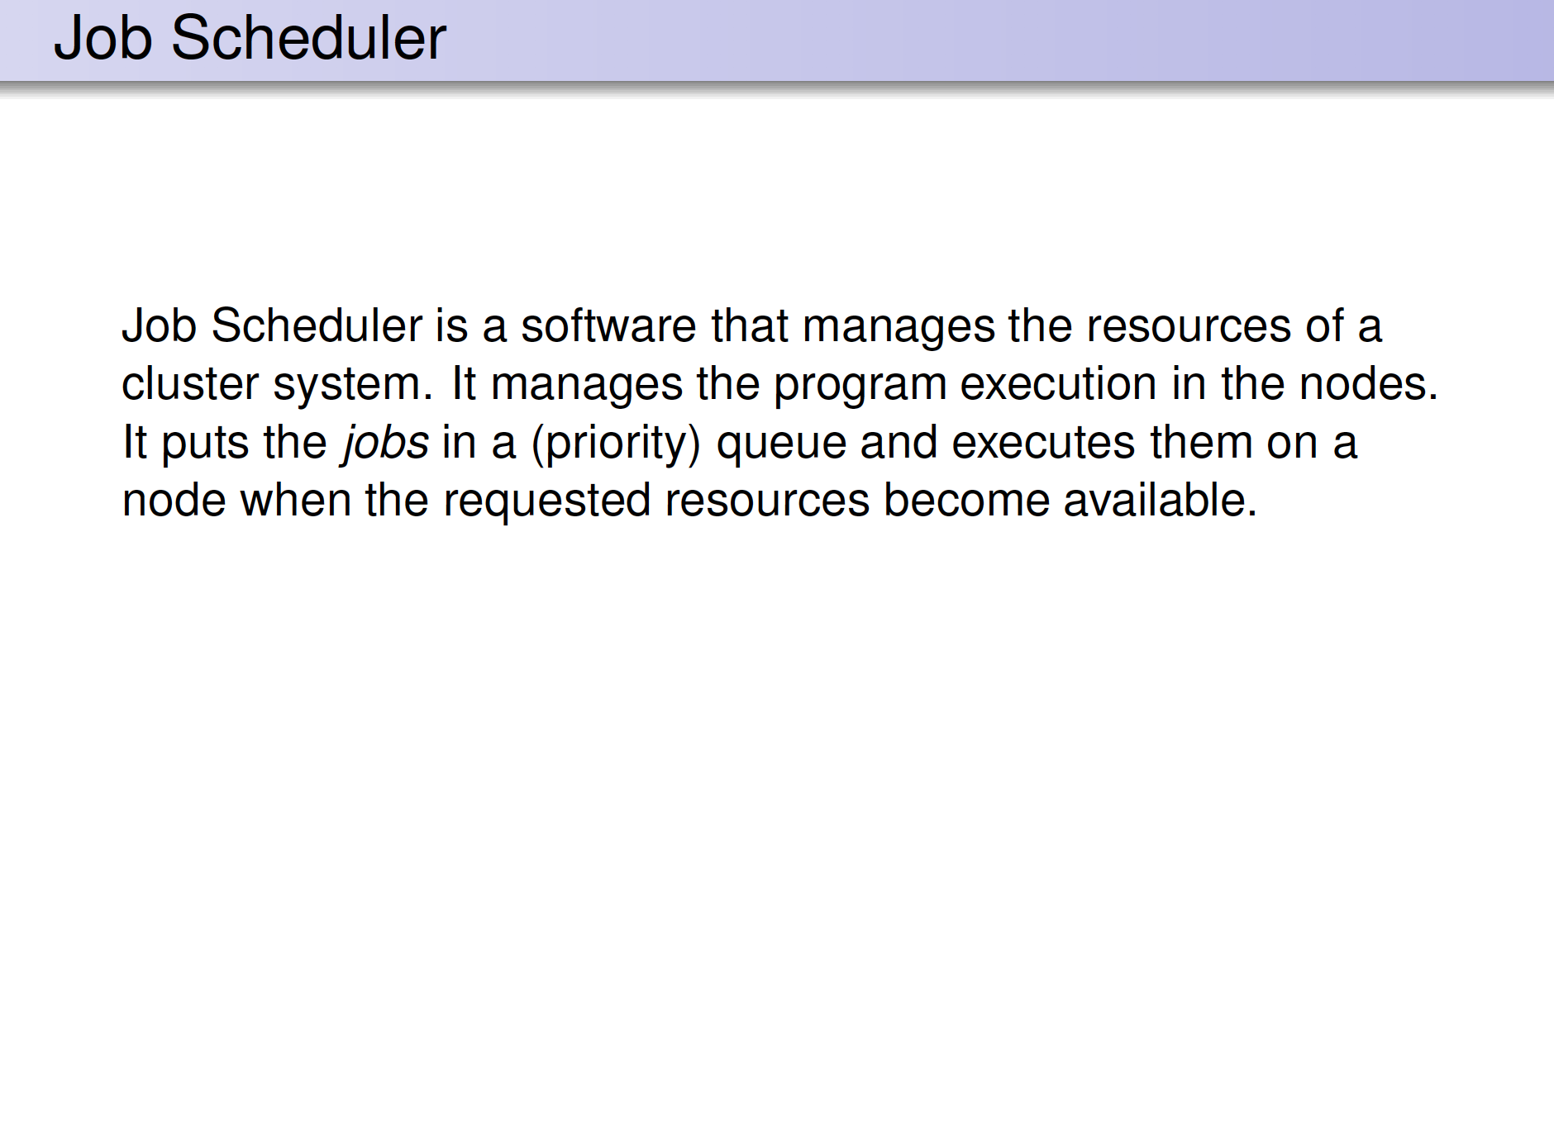

Slide 12
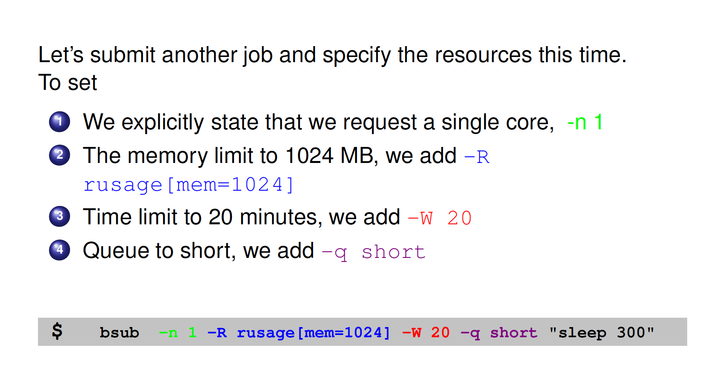
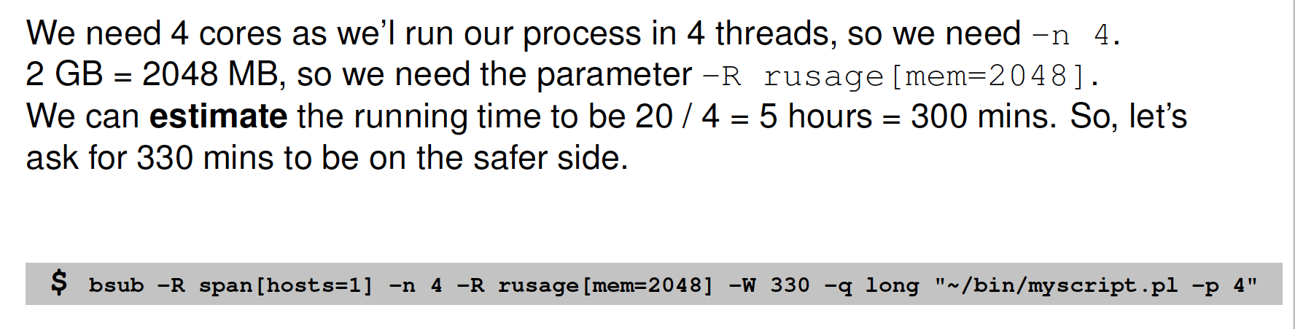

Slide 13
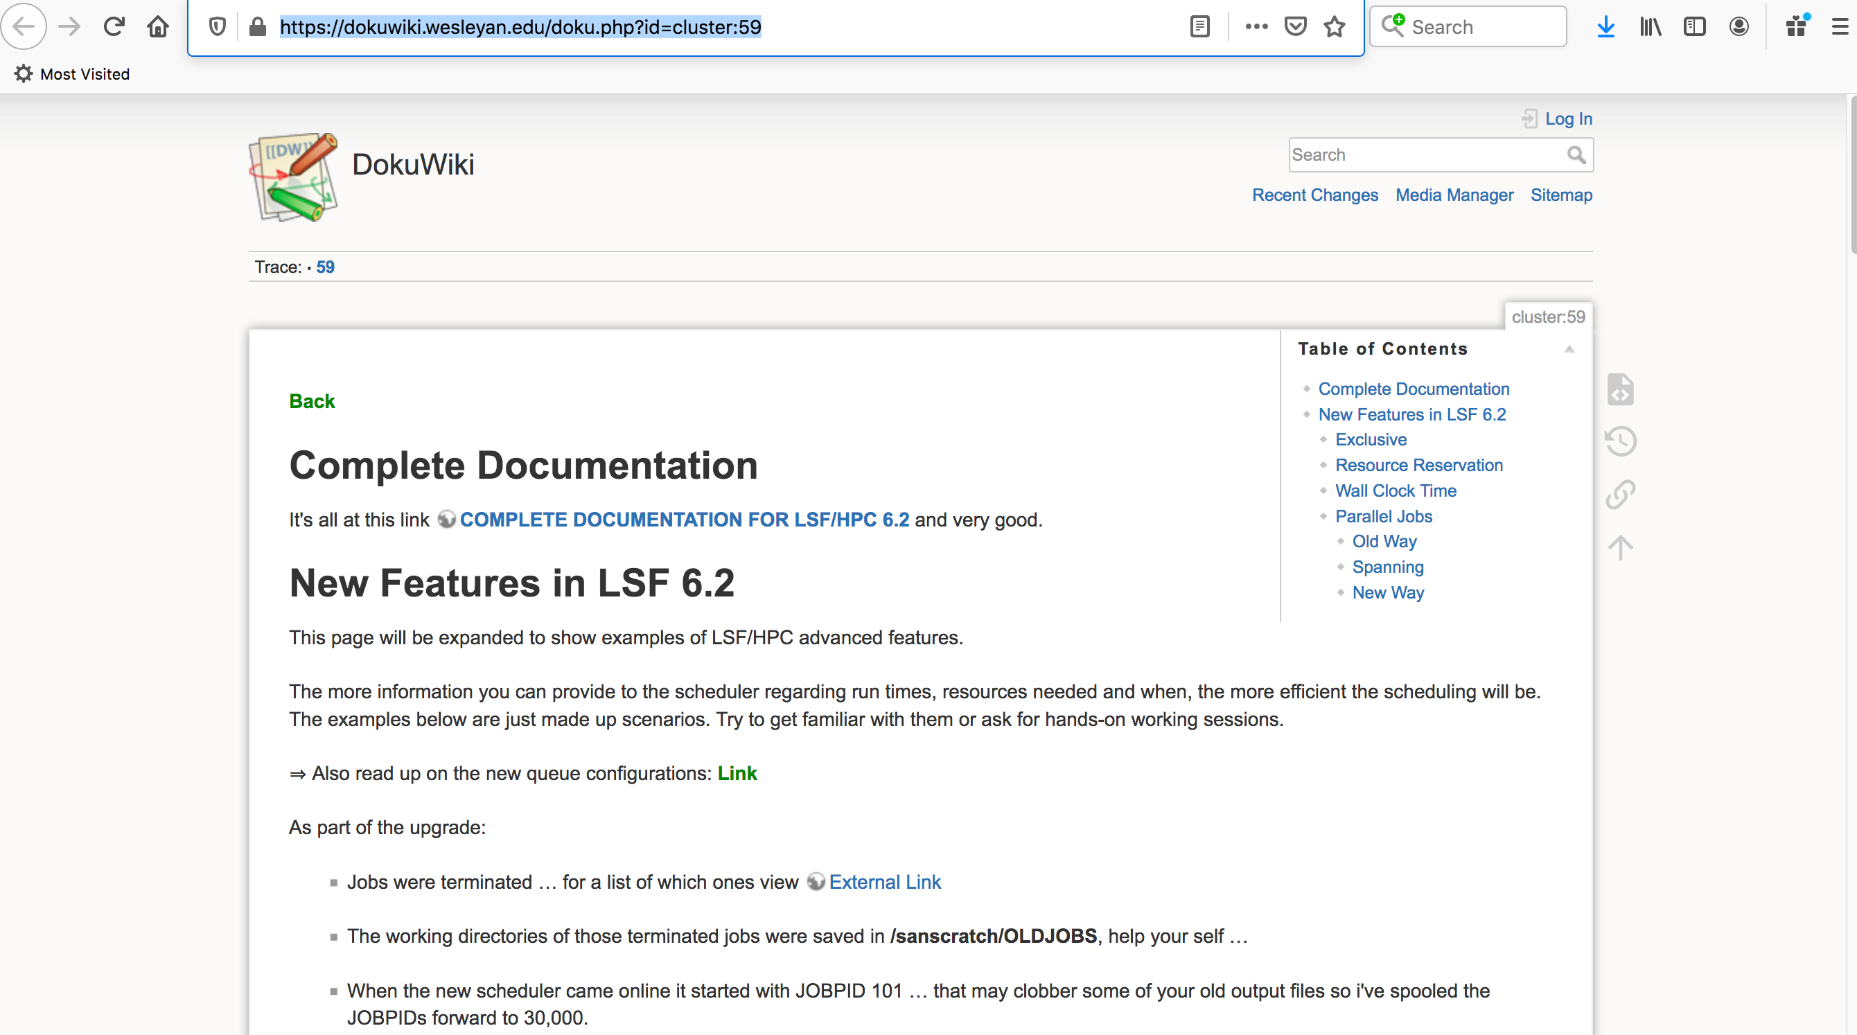
https://dokuwiki.wesleyan.edu/doku.php?id=cluster:59

Slide 14
Running Jobs on Linux/Cluster
http://barc.wi.mit.edu/education/hot_topics/lsf/Running_jobs_on_Linux_Cluster.pdf
bjobs checking submitted jobs
bjobs –a checking recently ended jobs
bjobs -l JOBID see details of a particular job using the job id #
bpeek JOBID peek at the stdout and stderr output of unfinished job
bkill JOBID kills jobs

Slide 15
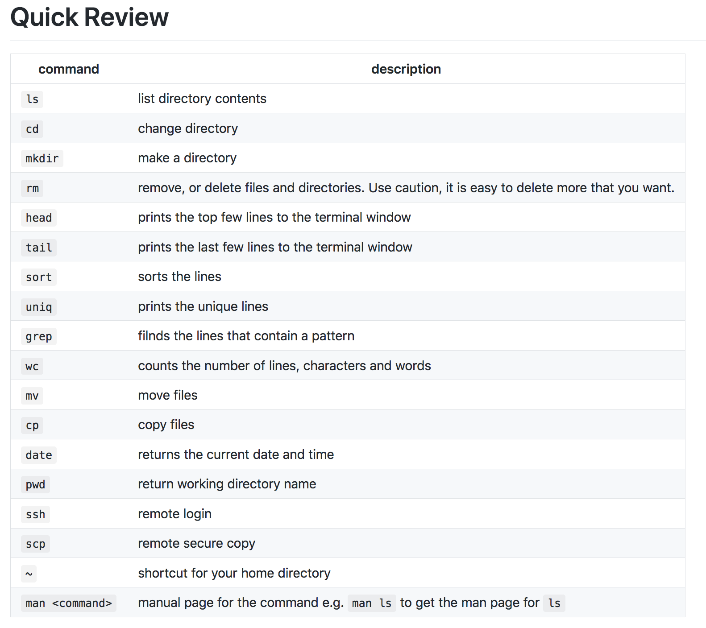
less or zless | read text files/read .gz compressed text files

Slide 17
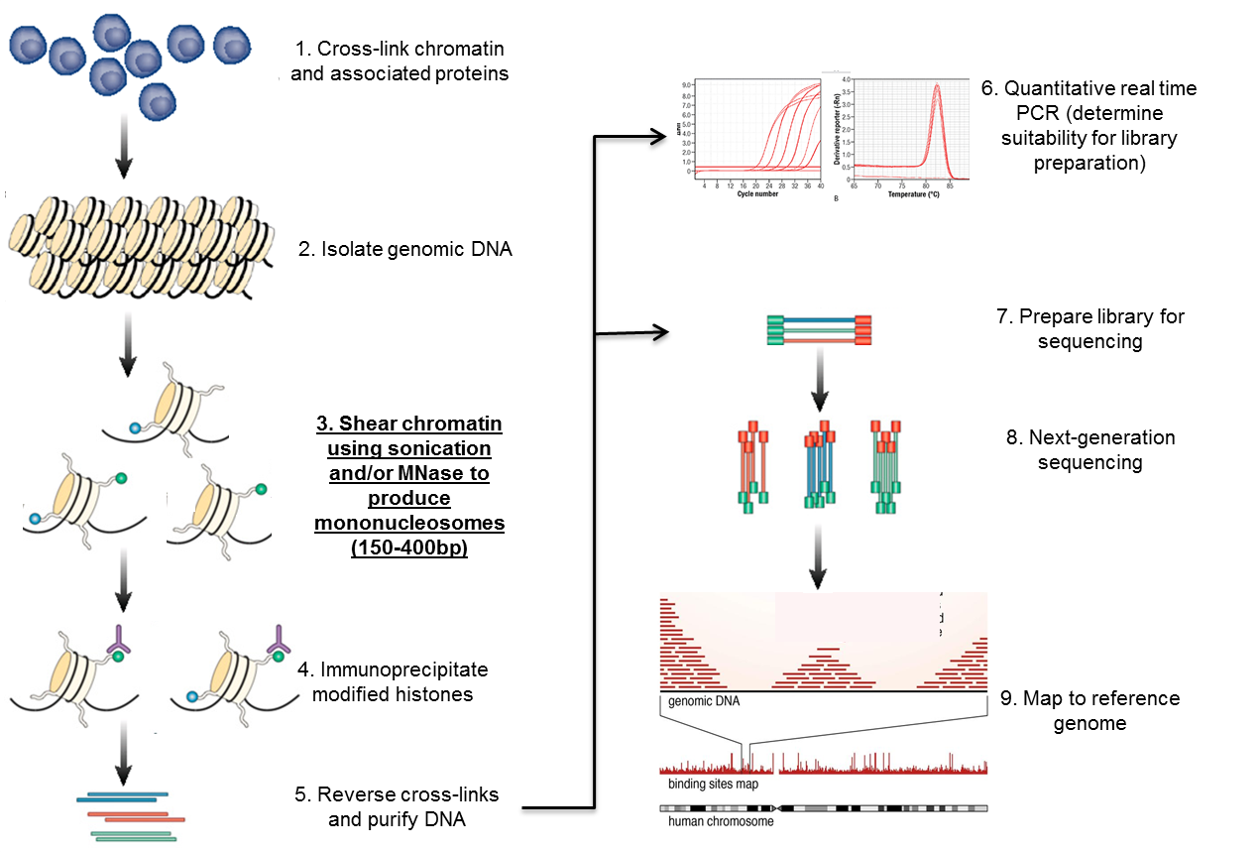
ChIP-Seq (Chromatin Immunoprecipitation)
Notes:
so we’ll start with ChIP-Seq which we’re all pretty familiar with. Up until this point, only targeted Prmt5 ChIPs have been done so this could be the first genome wide profiling done for Prmt5. I performed ChIP-Seq over the course of 3T3-L1 differentiation

Slide 18
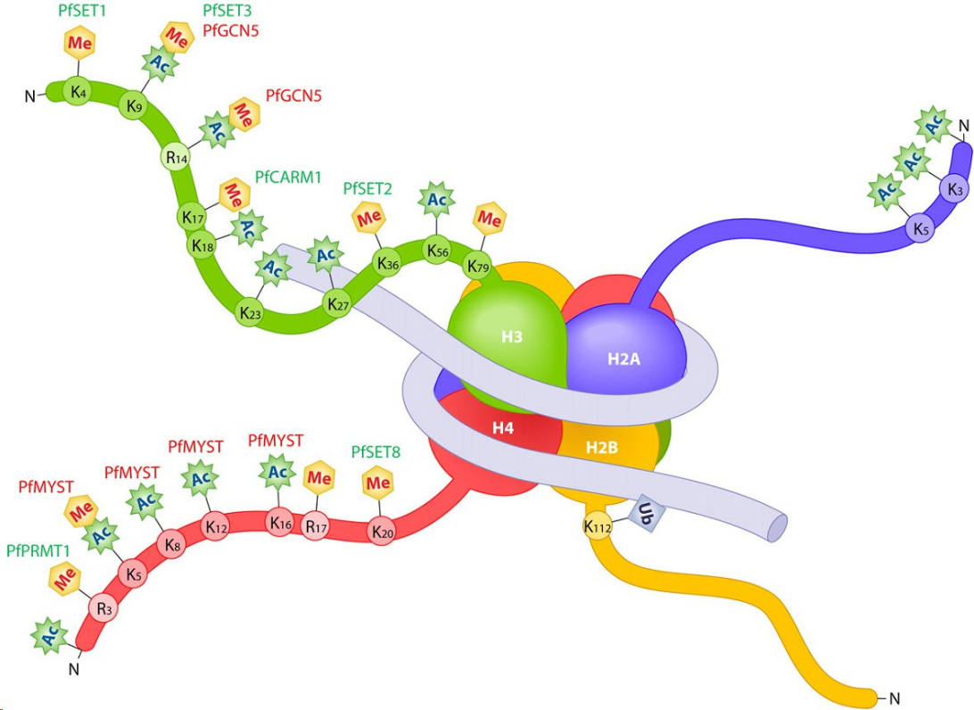
Control of gene expression by histone modifications
The nucleosome is made up of dimers of core histones H2A, H2B, H3, H4 with 147 base pairs of double stranded DNA wrapped around the nucleosome
Activating histone modifications
H3K4me3
H3K27ac
H4ac
H3K4me1
Repressive histone modifications
H3K27me3
H3K9me3
H2AK119ubi1
Amsbio http://www.amsbio.com/nucleosomes-and-histone-proteins.aspx

Slide 19
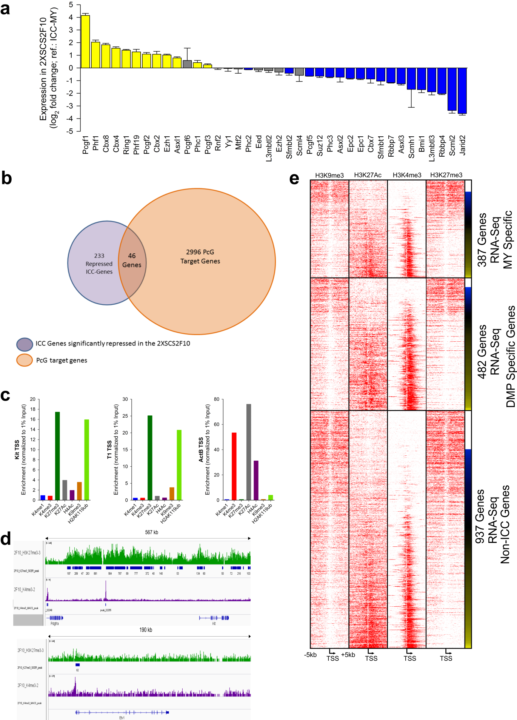
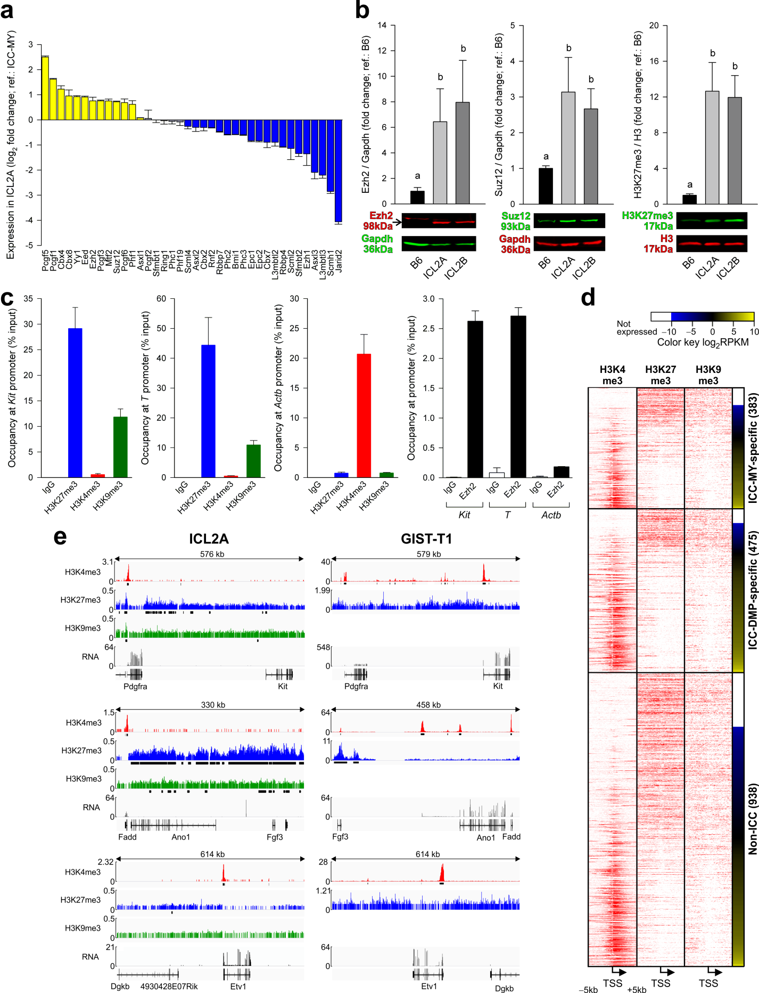
ChIP-qPCR
Activating histone modifications
H3K4me3
H3K27ac
H4ac
Repressive histone modifications
H3K27me3
H3K9me3
H2AK119ubi1
H3K4me1
Activating histone modifications
H3K4me3
H3K27ac
H4ac
Repressive histone modifications
H3K27me3
H3K9me3
H2AK119ubi1
H3K4me1

Slide 20
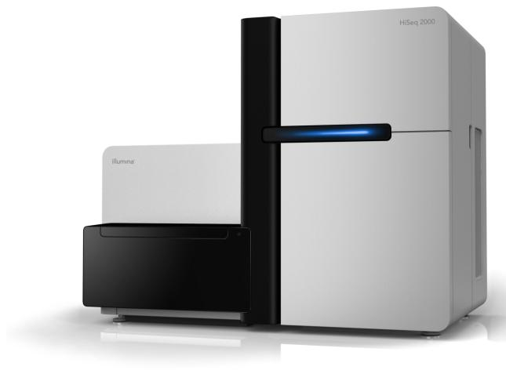
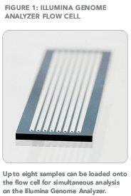
HiSeq 2000

Slide 21
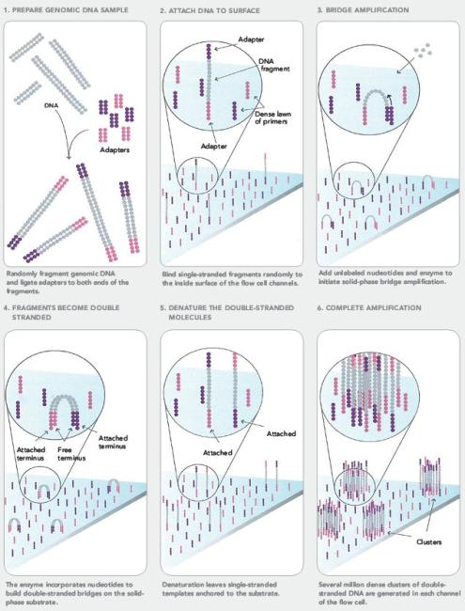
Illumina 2000 HiSeq Bridge Amplification

Slide 22
Bridge Amplification

Slide 23
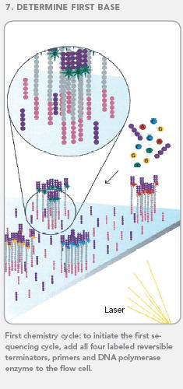

Slide 24
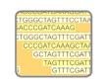
Raw Data is Images
8 channels per flow cell
300 tiles per channel
20,000 clusters/reads per tile
2400 images per reaction cycle
86,400 images for a 36-bp read length
700 GB of image data, 400 GB of files
Notes:
Camera has to take a picture of each tile at each reaction cycle, amounting to 2400 pictures per cycle. A 36-bp read would generates 86400 images.
Time required to take all those pictures is what makes the sequencing slow.
A “read” is the sequence produced from one cluster on the chip, corresponding to the sequence of one fragment.

Slide 25
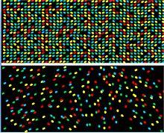

Slide 26
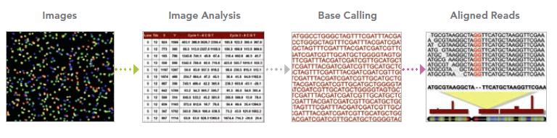
Interpret images as intensities
Convert intensities to base calls
Assemble reads into complete sequence
⇒ 36-bp read length
⇒ 4 to 6 million reads per flow cell lane

Slide 27
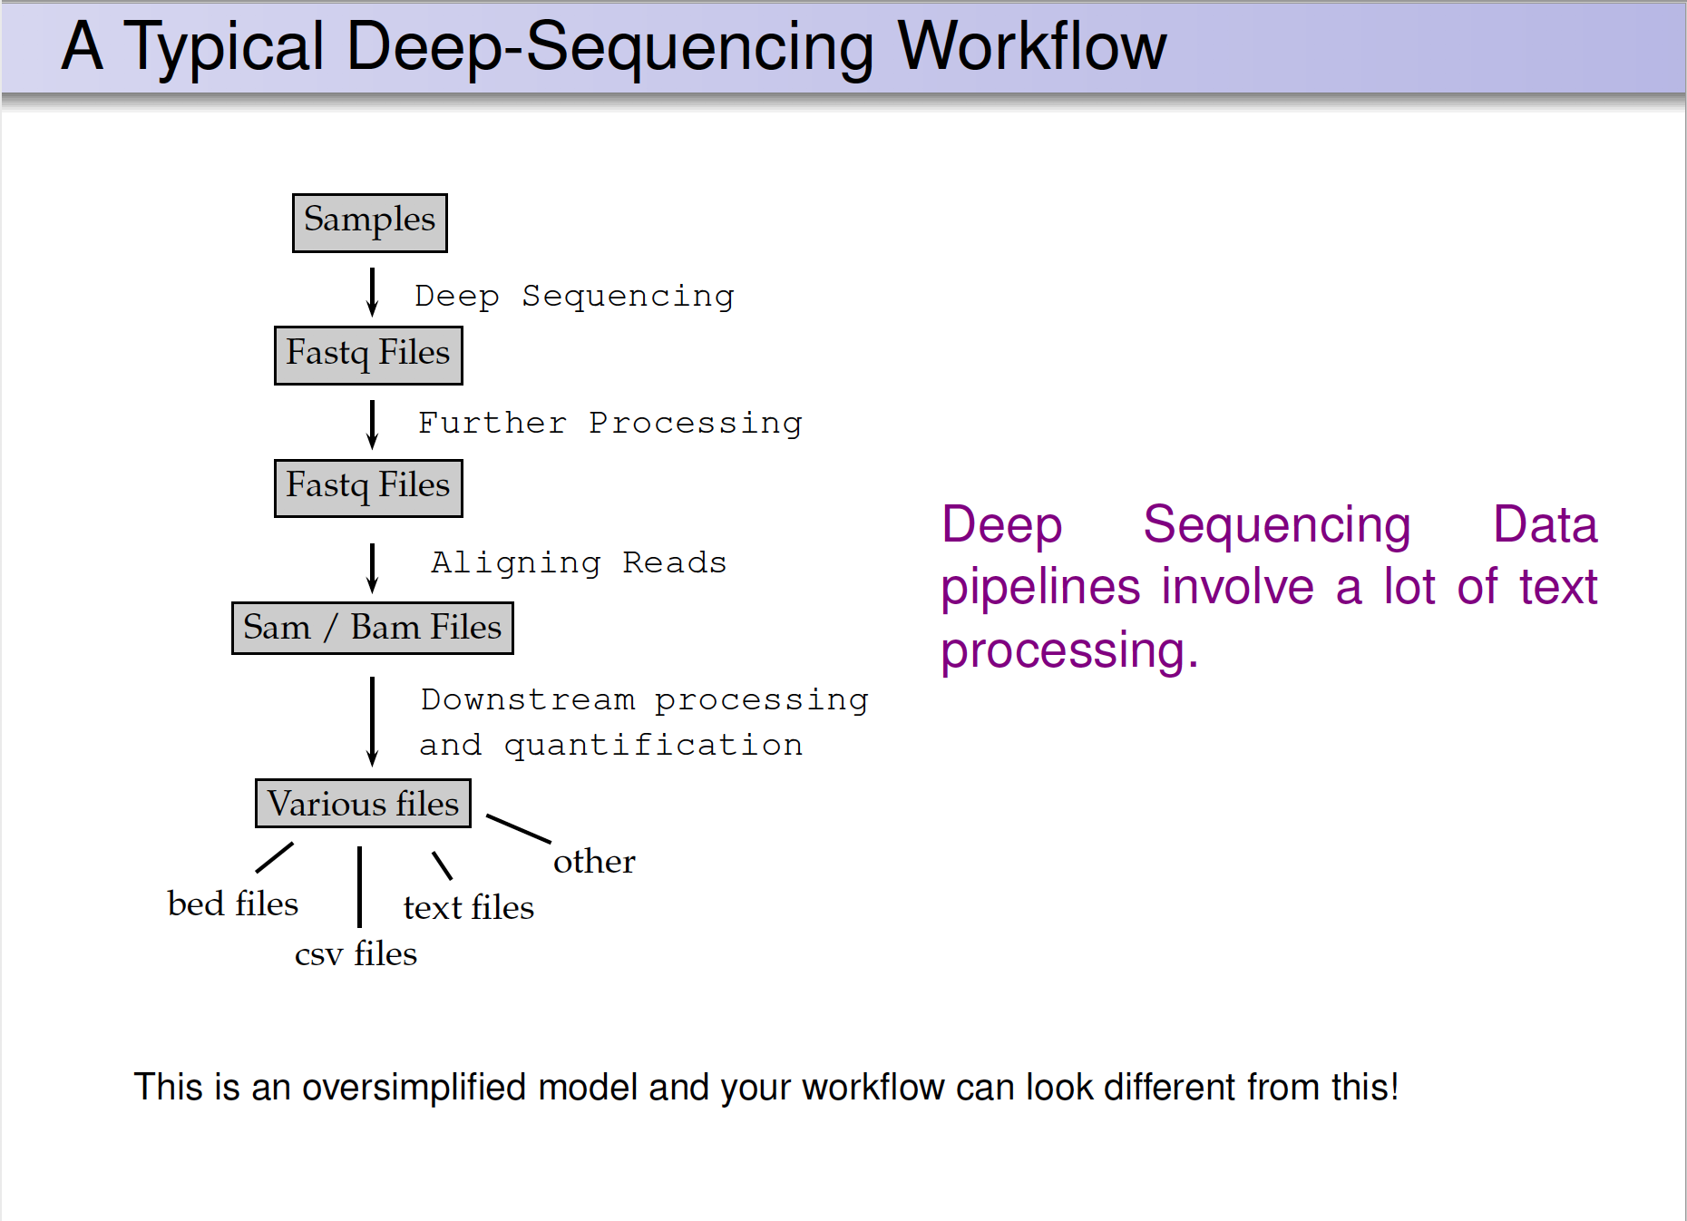
HiChIP pipeline

Slide 28
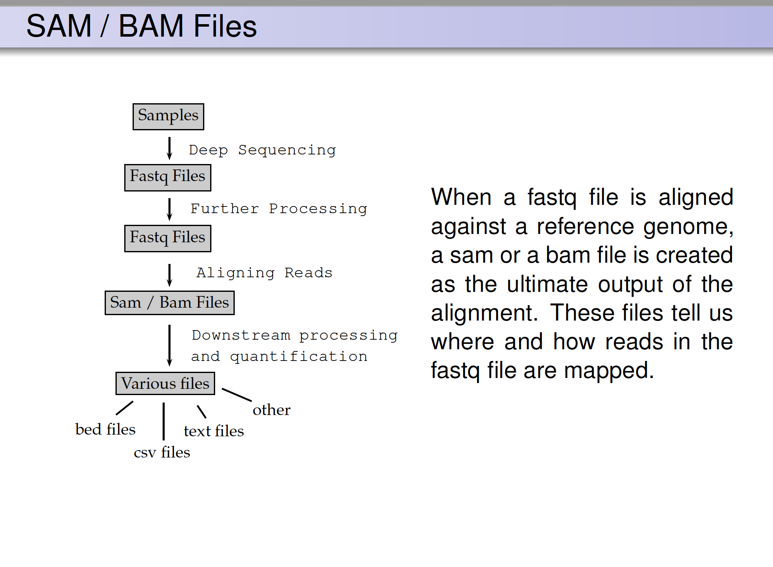
ChIP pipeline
FASTQ: a text-based format for storing nucleotide sequences (reads) and their quality scores. [1]
BAM: The Sequence Alignment/Mapping (SAM) format is a text-based format for storing read alignments against reference sequences and it is interconvertible with the binary BAM format. [2]

Slide 29
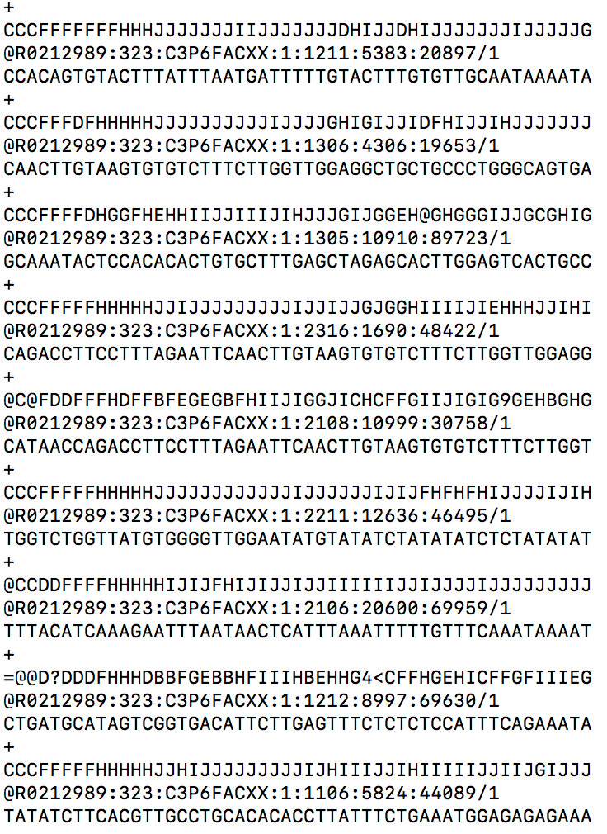
Sequencing Workflow
FASTQ: a text-based format for storing nucleotide sequences (reads) and their quality scores. [1]

Slide 30
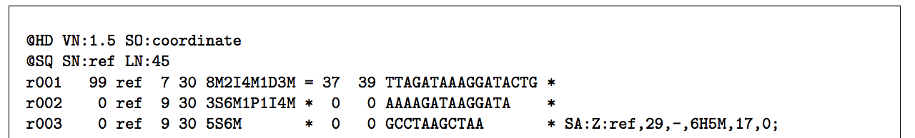
Sequencing Workflow
BAM: The Sequence Alignment/Mapping (SAM) format is a text-based format for storing read alignments against reference sequences and it is interconvertible with the binary BAM format.
Each alignment line has 11 mandatory fields for essential alignment information such as mapping position, and variable number of optional fields for flexible or aligner specific information.

Slide 31
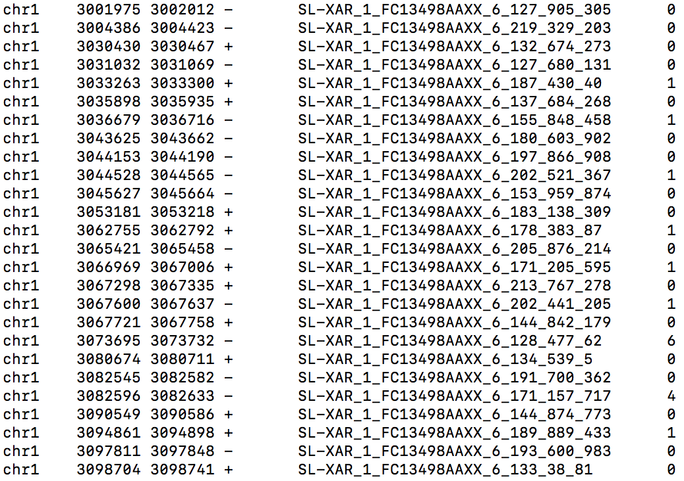
Sequencing Workflow
BED file

Slide 32
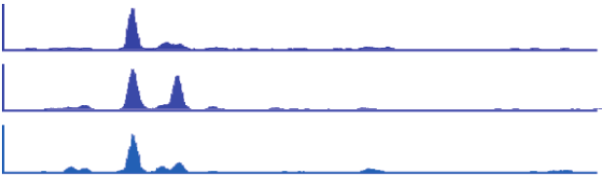

Binding profile
1 kb
Oct4
Nanog
Sox2
Oct4
(mouse Chr 17)
50 kb
H3K4me3
H3K36me3
FoxP1
(mouse Chr 3)
1 kb
RNAP II
ZFP36
(human Chr 19)
Kagey et al. (2010). Nature 467: 430
Mikkelsen et al. (2007). Nature 448: 553
Pepke et al. (2009). Nat. Methods 6: S22

Slide 33
My ChIP-Sequencing Workflow
Raw Reads
fastq
.tdf to visualize
(IGV tools)
Map to genome (Bowtie2)
Bam Index (picard)
Sort Sam
(picard)
MAPQ filter (samtools)
Peak Analysis
(macs2)
Mark duplicates
(picard)
Merge runs
(picard)

